Slide 1


Resumind
Smart, Fast and
Insightful Resume
Screening
Name : - Satvik Parihar
Enrollment No. : - 23002170510039
Batch : - A1
Branch : - AIDS

Slide 2

The Challenge in
Recruitment
Slow Screening
Manually going through resumes takes a lot of time and effort.
Bias
Recruiters’ unconscious biases can affect candidate selection.
Inconsistency
Different evaluators may judge the same resume differently.
Missed Talent
Qualified candidates can be overlooked in manual processes.

Slide 3

Technologies Powering Resumind
Frontend
Backend
APIs & Libraries
React: Dynamic and responsive user interface for seamless interaction.
Django: High-level Python web framework for robust backend logic.
Resume Parsing Libraries: Extract structured data from diverse resume formats.
Tailwind CSS: Utility-first CSS framework for rapid and consistent styling.
Django REST Framework: Powerful toolkit for building scalable APIs.
NLP Tools: Natural Language Processing for advanced skill and keyword extraction.
Vite: Fast build tool for an optimized development experience.
MySQL: Reliable relational database for efficient data storage.
Matplotlib / Chart.js: Generate insightful visualizations and reports.

Slide 4





How Resumind Works: The Workflow
Signup and Login
The user is asked to register/login before accessing analysis tools.
Resume Upload
Users effortlessly upload single resumes or process large batches.
Parsing Module
Our intelligent module extracts crucial data: skills, experience, education, and contact information.
Analysis & Scoring
Candidates are evaluated against job requirements, and an objective score and rank are assigned.
Reports & Visualization
Comprehensive reports and intuitive charts provide instant insights into candidate pools.

Slide 5
Advantages & Current Limitations
Advantages
Limitations
Time Savings: Drastically reduces manual screening hours.
Single Job Focus: Currently handles one job description at a time.
Accuracy: Ensures precise, skill-based candidate evaluation.
Fixed Scoring: Scoring techniques are fixed, limiting advanced flexibility.
Visualization: Clear, easy-to-understand ranking and insights.
Customizable: Adaptable for diverse job roles and industries.

Slide 6
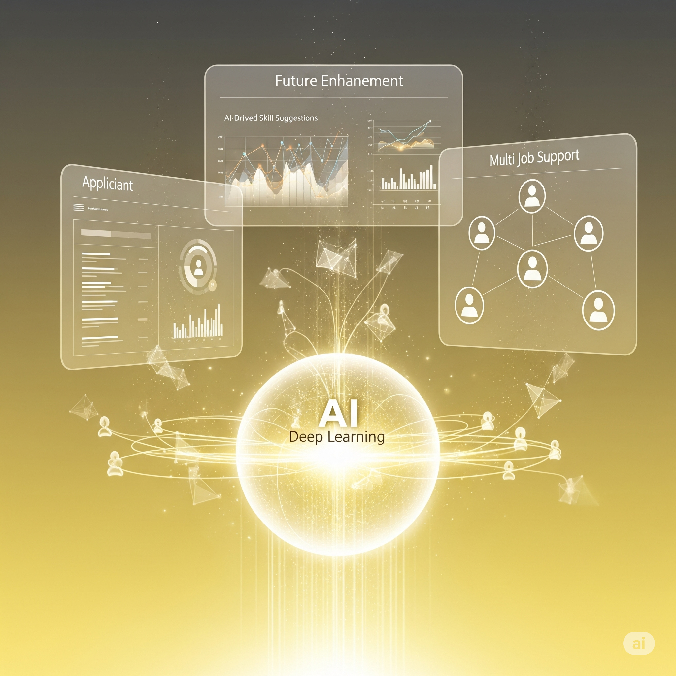






Future Scope & Enhancements
Applicant Interface
Develop a portal for candidates to check their ATS score and build resumes.
AI Skill Suggestions
Integrate AI to suggest relevant skills, enriching candidate profiles.
Job Portal Integration
Connect with major job boards for seamless posting and candidate sourcing.
Deep Learning
Implement advanced deep learning for superior resume parsing accuracy.
Customizable Reports
Allow users to select the weightage of each factor in the report generation
Multi-Job Support
Expand functionality to process resumes for multiple jobs.

Slide 7

Thank You!

